Slide 1
MR REPORTING APP

Slide 2

MR REPORTING APP
Submitted By : - M.C.A. (Lateral Entry ) Semester-VI
CHIRAYU D. PANDIT Enrollment No :- 14084212018
AKSHAY N. MANGUKIYA
Enrollment No :- 14084212015
Guided by
Dr Jigneshkumar A. Chauhan
Submitted to Department of Computer Science
Ganpat University

Slide 3
Project Title | MR Reporting App.
Project category | Web Application
Objective | MR can report their live daily activities through this App
Front End | Android 4.0.3
Back End | MySQL 5.6.17
Tool | Adobe Dreamweaver CS5.5
Server | Wampserver 2.2
Documentation Tool | Microsoft Office 2010
Internal Guide | Dr. Jigneshkumar A. Chauhan
Developed By | Krunal J. Patel (13034212049)
Company Name | IAC INFOTECH LT,
External Guide | Mr.Vijay A. Chauhan
Group No | 15

Slide 4
1. PROJECT PROFILE
Project Title :- MR Reporting App.
Objective :- MR can report their live daily activities through this App
Scope :- Android Device is needed. User should have basic knowledge of using Android device. Internet is mandatory.
Front – End :- Android 4.0.3
Back – End :- MySQL 5.6.17
Documentation Tool :- Microsoft Office 2013.
Developed By :- Chirayu D. Pandit (14084212018) Akshay N. Mangukiya (14084212015)
Group No :- 12
Internal Guide :- Prof. Jignesh A. Chauhan
Coordinator :- Prof. Jignesh A. Chauhan
Team Size :- 2 Person

Slide 5
2. REQUIREMET SPECIFICATION EXISTING SYSTEM
MR Report their activities on weekends.
Live and accurate status of all MR can not be achieved.
MR Reports their activities on excel sheets.
Data are Hard to maintain.
Difficult to find queried summarized result.
Expense calculation can become a tedious task.

Slide 6
2.1 NEED FOR NEW SYSTEM
MR can report their activities on daily basis.
All the senior officers can find the live status of their MR respectively.
MR activities can be analyzed by time, visits and distance.
The most recent location of MR can be find easily.
Expense calculation can be done easily.
Sample and gift distribution can be done easily.
MR can easily identify their daily targets and work details.
MR can easily find their destination location through map.

Slide 7
2.2 USED HARDWARE AND SOFTWARE CLINET SIDE
HARDWARE:-
Any Compatible Android Mobile
SOFTWARE:-
Android Version:- 4.0.3(Ice Cream Sandwich)

Slide 8
SERVER SIDE
HARDWARE:- Processor :- Intel Core i3
RAM:- 4GB
HDD:- 500 GB
SOFTWARE:-
Supporting Tools:- Android Studio 1.3.3, wamp server 2.5
Operating System:- Windows 10 Home

Slide 9
3. FUNCTIONAL MODULE SPECIFICATION
Login:-
MR and ABM can have access of this application by successful login.
Reporting:-
MR and ABM can report their daily activities through this app.
Salsecard:-
MR can report his own salsecard about the medicine he sold to the doctor.
Tour Planner:-
MR and ABM can plan his tour for next month.
Gift Distribution:-
MR can report his gift distribution Activity through the App.

Slide 10
ABM Executive Amount:-
ABM can Report his daily Executive Activity through this app.
Expense Report:-
MR and ABM can claim their expenses easily.
Profile:-
MR and ABM can manage his profile detail.
Team report:-
ABM can analyze his allocated MR’s daily report and tour planner details.
Map:-
MR and ABM can find their destination location easily.

Slide 11
4. SYSTEM FLOW CHART

Slide 12
Start
Enter Username & Password
Is Valid ?
No
Yes
Is MR
Is MR/ABM?
Is ABM
Dashboard
Manage Daily Report
Manage Tour Planner
View Expense Report
Manage Profile
Change Password
View Map
Manage Salescard Report
ABM Executive Amount
Gift Distribution
View Team Report
View Daily Report
View Tour Report
Logout
Stop

Slide 13
5.1 Use-Case Diagram

Slide 14
MR Reporting
Login
View Dashboard
Manage Daily Report
Manage Tour Planner
Manage Sales Card Report
ABM Executive Amount
Gift Distribution
View Team Report
MR
ABM
View Expense Report
Manage Profile
Change Password
View Map
Logout

Slide 15
5.2 Class Diagram

Slide 16
Gift Distribution
+ date + gift + city + area + doctor
+Add() +View()
Map
+ lat + long
+View()
Change password
- password
+Update()
Profile
+ name + dob + email + mobile + address
+View() +Update()
1
1
Salescard
+ date + campaign + product + units
+Add() +View()
1
1
*
ABM Executive Amount
+ date + city + misi + remark
+Add() +View()
*
*
1
1
1
1
Login
+ username - password
+Login() +Logout()
1
Daily Report
+ date + campaign + city + doctor + remark
+Add() +View()
1
1
1
*
*
Expense
+ date + km + kmrate + misi
+Add() +Search()
*
Tour Planner
+ month + from city + to city + area
+Add() +View()
Team Report
+ name + date
+View() +Search()
*
*
*
*

Slide 17
5.3 Sequence Diagram

Slide 18
Sequence Diagram for MR

Slide 19
Login
Watchlist
Holdings
Predictions
:
:
:
:
:
:
User
Request for login
Request to manage Watchlist
Authenticate
Successful
Successfully
Managed watchlist
Request to manage Holdings
Successfully managed sales card report
Request to get Prediction
Successfully managed Predictions
Request for logout
Logged out
Successfully

Slide 20
Sequence Diagram for ABM

Slide 21
Login
Daily Report
Executive Amount
Tour Planner
Expense Report
Team Report
Change Password
Profile
Map
:
:
:
:
:
:
:
:
:
:
ABM
Request for login
Request to manage daily report
Authenticate
Successful
Successfully
Managed daily report
Request to manage Executive Amount
Successfully Managed Executive Amount
Request to manage tour planner
Successfully Managed tour planner
Request to view expense report
Successfully viewed expense report
Request to view team report
Successfully viewed team report
Request to change password
Successfully Update change password
Request to manage profile
Request for logout
Successfully Managed profile
Request to view Map
Logged out
Successfully
Successfully viewed map

Slide 22
5.4 Activity Diagram

Slide 23
Activity Diagram for MR

Slide 24
Login
Is Not Valid
Is Valid
Manage Watchlist
Manage Holdings
View Predictions
Logout

Slide 25
Activity Diagram for ABM

Slide 26
Login
Is Not Valid
Is Valid
Manage Daily Report
Manage
ABM Executive Amount
Manage Tour Planner
View Expanse Report
View Team Report
Manage Profile
Change Password
View Map
Logout

Slide 27
5.5 Deployment Diagram

Slide 28
Application Server
Database
Server
User’s Device
Device

Slide 29
6. Data Dictionary

Slide 30
1. tbl_employee
DESCRIPTION :- Represents Employee details
Primary Key : empid
Sr.No | Field Name | Data Type | Constraint | Description
1 | empid | int(5) | Primary Key | Represents employee ID
2 | firstname | varchar(30) | Not Null | Represents Employee’s First name
3 | lastname | varchar(30) | Not Null | Represents Employee’s Last name
4 | fathername | varchar(30) | Not Null | Represents Employee’s Father name
5 | dob | Date | Not Null | Represents Employee’s Birth Date
6 | username | varchar(30) | Not Null | Represents Employee’s Username
7 | pass | varchar(20) | Not Null | Represents Employee’s Password

Slide 31
Cont…. tbl_employee
Sr.No | Field Name | Data Type | Constraint | Description
8 | emailid | varchar(50) | Not Null | Represents Employee’s email ID
9 | mnumber | int(10) | Not Null | Represents Employee’s Mobile Number
10 | lnumber | int(10) | Not Null | Represents Employee’s landline number
11 | maddress | varchar(50) | Not Null | Represents Employee’s Current Address
12 | paddress | varchar(50) | Not Null | Represents Employee’s permeant address
13 | mstatus | varchar(7) | Not Null | Represents Employee’s marital status
14 | anniversay | date | Not Null | Represents Employee’s anniversary date
15 | joining | date | Not Null | Represents Employee’s joining date
16 | desid | int(5) | Not Null | Represent Employee’s designation ID From tbl_post

Slide 32
Cont…. tbl_employee
Sr.No | Field Name | Data Type | Constraint | Description
17 | stateid | int(5) | Not Null | Represents Employee’s State ID From tbl_state
18 | headid | int(5) | Not Null | Represents Employee’s head ID From tbl_headqueater
19 | cityid | int(5) | Not Null | Represents Employee’s city ID From tbl_city
20 | areaid | int(5) | Not Null | Represents Employee’s Area ID From tbl_area
21 | kmsrate | double | Not Null | Represents Employee’s KM Rate
22 | target | Varchar(2) | Not Null | Represents Employee’s call Target
23 | report_to_des | int(5) | Not Null | Represents report to designation
24 | report_to_name | int(5) | Not Null | Represents report to employee name
25 | emp_status | int(1) | Not Null | Represents employee status

Slide 33
2. tbl_allocation_employee
DESCRIPTION :- Represents employee allocation details
Primary Key : allocateid
Sr.No | Field Name | Data Type | Constraint | Description
1 | allocateid | int(5) | Primary Key | Represents Employee allocation ID
2 | empid | int(5) | Not Null | Represents Employee ID From tbl_employee
3 | doctorid | int(5) | Not Null | Represents doctor id From Create_doctor
4 | cityid | int(5) | Not Null | Represents City Id From tbl_city
5 | areaid | int(5) | Not Null | Represents Area id From tbl_area

Slide 34
3. tbl_area
DESCRIPTION :- Represents area details
Primary Key : areaid
Sr.No | Field Name | Data Type | Constraint | Description
1 | areaid | int(5) | Primary Key | Represents Area ID
2 | stateid | int(5) | Not Null | Represents State ID From tbl_state
3 | headid | int(5) | Not Null | Represents head id From tbl_headquater
4 | cityid | int(5) | Not Null | Represents City Id From tbl_city
5 | areaname | varchar(50) | Not Null | Represents Area name

Slide 35
4. tbl_campaign
DESCRIPTION :- Represents campaign details
Primary Key : campid
Sr.No | Field Name | Data Type | Constraint | Description
1 | campid | int(5) | Primary Key | Represents camping ID
2 | campaign | varchar(10) | Not Null | Represents camping name
3 | startdate | date | Not Null | Represents camping starting date
4 | enddate | date | Not Null | Represent camping ending date

Slide 36
5. tbl_city
DESCRIPTION :- Represents city details
Primary Key : cityid
Sr.No | Field Name | Data Type | Constraint | Description
1 | cityid | int(5) | Primary Key | Represents City ID
2 | stateid | int(5) | Not Null | Represents State ID From tbl_state
3 | headid | int(5) | Not Null | Represents head id From tbl_headquater
4 | cityname | varchar(50) | Not Null | Represents City name

Slide 37
6. tbl_createdoctor
DESCRIPTION :- Represents doctor details
Primary Key : doctorid
Sr.No | Field Name | Data Type | Constraint | Description
1 | doctorid | int(5) | Primary Key | Represents doctor ID
2 | fullname | varchar(30) | Not Null | Represents doctor’s full name
3 | gender | varchar(6) | Not Null | Represents doctor’s gender
4 | stateid | int(5) | Not Null | Represents State Id From tbl_state
5 | headid | int(5) | Not Null | Represents Head ID From tbl_headquater
6 | cityid | int(5) | Not Null | Represents City ID From tbl_city
7 | areaid | int(5) | Not Null | Represents Area ID From tbl_area

Slide 38
7. tbl_empdailyreport
DESCRIPTION :- Represents employee daily report details
Primary Key : dailyid
Sr.No | Field Name | Data Type | Constraint | Description
1 | dailyid | int(5) | Primary Key | Represents daily report ID
2 | empid | int(5) | Not Null | Represents employee ID From tbl_employee
3 | campid | int(5) | Not Null | Represents camp id From tbl_campaign
4 | fromcity | int(5) | Not Null | Represents city Id From tbl_city
5 | cityid | int(5) | Not Null | Represents City id from tbl_city
6 | areaid | int(5) | Not Null | Represents Area id from tbl_area

Slide 39
Cont…. tbl_empdailyreport
Sr.No | Field Name | Data Type | Constraint | Description
7 | doctorid | int(5) | Not Null | Represents doctor ID from tbl_createdoctor
8 | target | int(5) | Not Null | Represents employee’s call target
9 | acaltarget | int(5) | Not Null | Represents achieved call target
10 | kms | double | Not Null | Represents KM
11 | kmstot | double | Not Null | Represents Km rate
12 | date | date | Not Null | Represents date
13 | remark | longtext | Not Null | Represents remark

Slide 40
Cont…. tbl_empdailyreport
Sr.No | Field Name | Data Type | Constraint | Description
14 | soid | int(5) | Not Null | Represents employee id
15 | misi | int(5) | Not Null | Represents Miscellaneous amount
16 | groupid | int(5) | Not Null | Represents group id
17 | currentt_date | Timestamp | Not Null | Represents current date and time
18 | meeting | int(1) | Not Null | Represents meeting
19 | lat | varchar(15) | Not Null | Represents latitude of employee location
20 | long | varchar(15) | Not Null | Represents longitude of employee location

Slide 41
7. tbl_headquater
DESCRIPTION :- Represents headquater details
Primary Key : headid
Sr.No | Field Name | Data Type | Constraint | Description
1 | headid | int(5) | Primary Key | Represents headquarter ID
2 | stateid | int(5) | Not Null | Represents state ID from tbl_state
3 | headquatername | varchar(30) | Not Null | Represents headquarter name

Slide 42
8. tbl_product
DESCRIPTION :- Represents Product details
Primary Key : productid
Sr.No | Field Name | Data Type | Constraint | Description
1 | productid | int(5) | Primary Key | Represents Product ID
2 | productname | varchar(30) | Not Null | Represents product name
3 | price | double | Not Null | Represents product price

Slide 43
9. tbl_root
DESCRIPTION :- Represents Km of Root details
Primary Key : id
Sr.No | Field Name | Data Type | Constraint | Description
1 | id | int(5) | Primary Key | Represents root ID
2 | fromcity | int(5) | Not Null | Represents cityid from tbl_city
3 | tocity | int(5) | Not Null | Represents cityid from tbl_city
4 | km | int(3) | Not Null | Represents km of root

Slide 44
10. tbl_root_planer
DESCRIPTION :- Represents root planner details
Primary Key :- id
Sr.No | Field Name | Data Type | Constraint | Description
1 | id | int(5) | Primary Key | Represents Root planner ID
2 | cdate | date | Not Null | Represents current date
3 | fromcity | int(5) | Not Null | Represents cityid from tbl_city
4 | tocity | int(5) | Not Null | Represents cityid from tbl_city
5 | areaid | int(5) | Not Null | Represents areaid from tbl_area
6 | empid | int(5) | Not Null | Represents Employee id from tbl_employee

Slide 45
11. tbl_state
DESCRIPTION :- Represents state details
Primary Key : stateid
Sr.No | Field Name | Data Type | Constraint | Description
1 | stateid | int(5) | Primary Key | Represents state ID
2 | statename | varchar(50) | Not Null | Represents state name

Slide 46
12. tbl_salsecard
DESCRIPTION :- Represents sold product details
Primary Key :- sid
Sr.No | Field Name | Data Type | Constraint | Description
1 | sid | int(5) | Primary Key | Represents salsecardID
2 | empid | int(5) | Not Null | Represents Employee’s id from tbl_employee
3 | campid | int(5) | Not Null | Represents campaign id from tbl_campaign.
4 | productid | int(5) | Not Null | Represents productid from tbl_product
5 | prices | float | Not Null | Represents price of product
6 | unit | int(10) | Not Null | Represents Units of products
7 | total | float | Not Null | Represents Total price of products
8 | date | date | Not Null | Represents Date of salsecard

Slide 47
13. tbl_allocation_gift
DESCRIPTION :- Represents Gift allocation details
Primary Key :- id
Sr.No | Field Name | Data Type | Constraint | Description
1 | id | int(5) | Primary Key | Represents Gift alloction ID
2 | empid | int(5) | Not Null | Represents Employee’s id from tbl_employee
3 | giftid | int(5) | Not Null | Represents Gift id from tbl_gift.
4 | nitem | int(10) | Not Null | Represents number of items
5 | cdate | date | Not Null | Represents Date

Slide 48
14. tbl_gift
DESCRIPTION :- Represents Gift details
Primary Key :- giftid
Sr.No | Field Name | Data Type | Constraint | Description
1 | giftid | int(5) | Primary Key | Represents Gift id
2 | gift_name | varchar(15) | Not Null | Represents Gift Name
3 | startdate | date | Not Null | Represents Gift Starting Date.
4 | enddate | date | Not Null | Represents Ending Date

Slide 49
15. tbl_distribution_gift
DESCRIPTION :- Represents Distribution gift details
Primary Key :- id
Sr.No | Field Name | Data Type | Constraint | Description
1 | id | int(5) | Primary Key | Represents gift Distribution id
2 | empid | int(5) | Not Null | Represents Employee’s id from tbl_employee
3 | giftid | int(5) | Not Null | Represents Gift id from tbl_gift table.
4 | cityid | int(5) | Not Null | Represents city id from tbl_city
5 | areaid | int(5) | Not Null | Represents area id from tbl_area
6 | doctorid | int(5) | Not Null | Represents doctor id from tbl_createdoctor
7 | gdate | date | Not Null | Represents gift distribution date

Slide 50
7. Input & Output Design

Slide 51
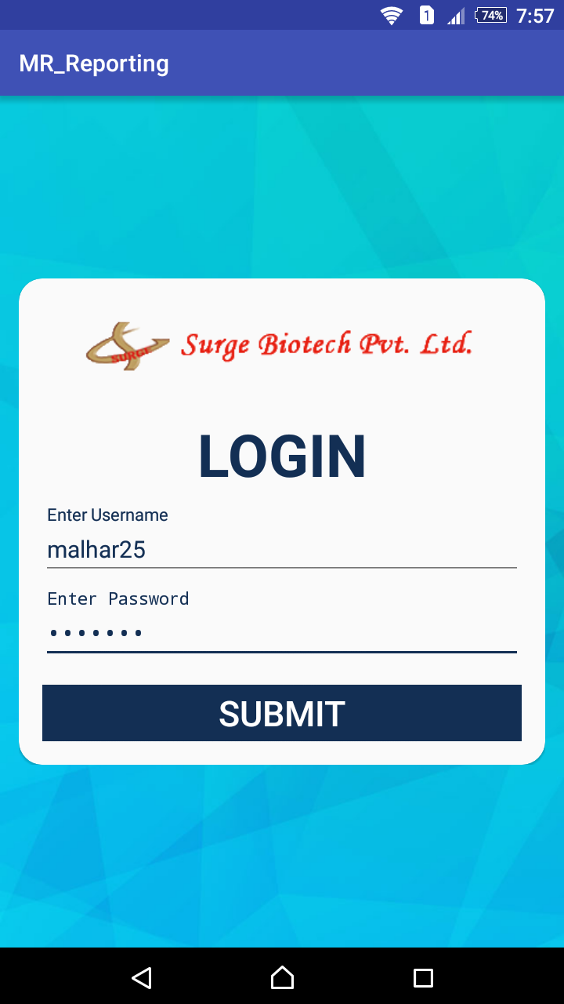
LOGIN ACTIVITY

Slide 52
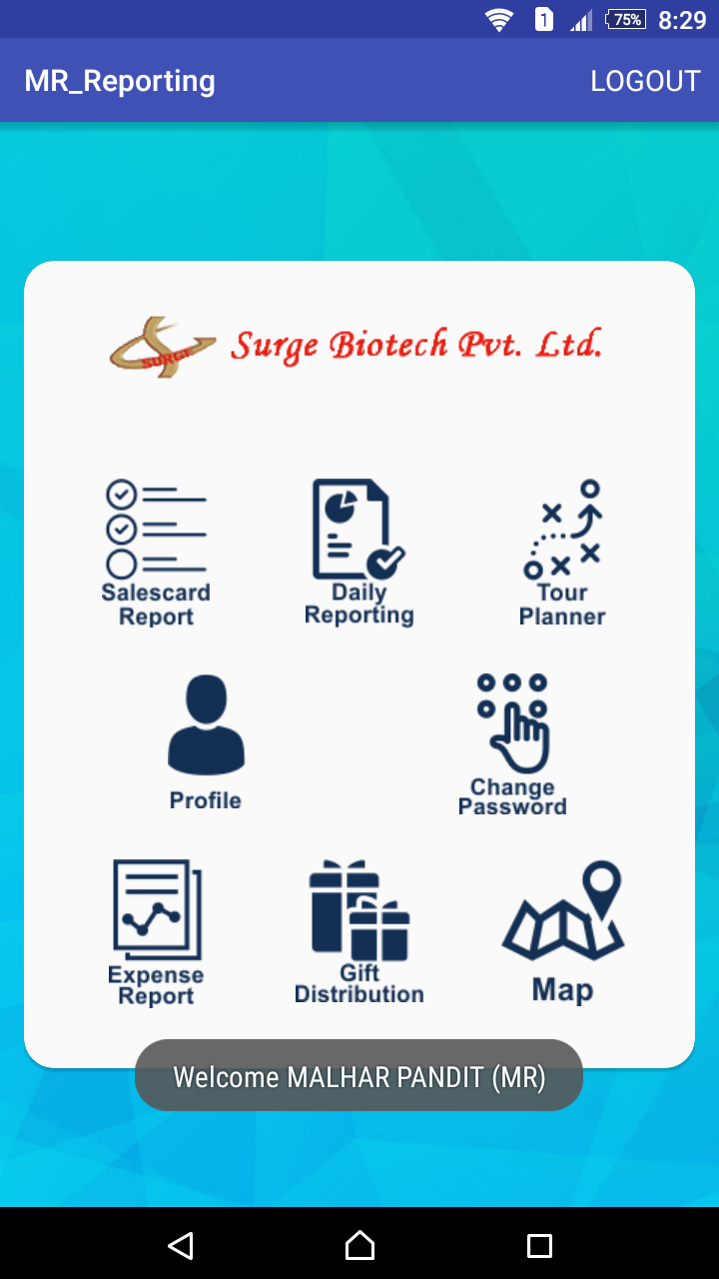
MR DASHBOARD

Slide 53
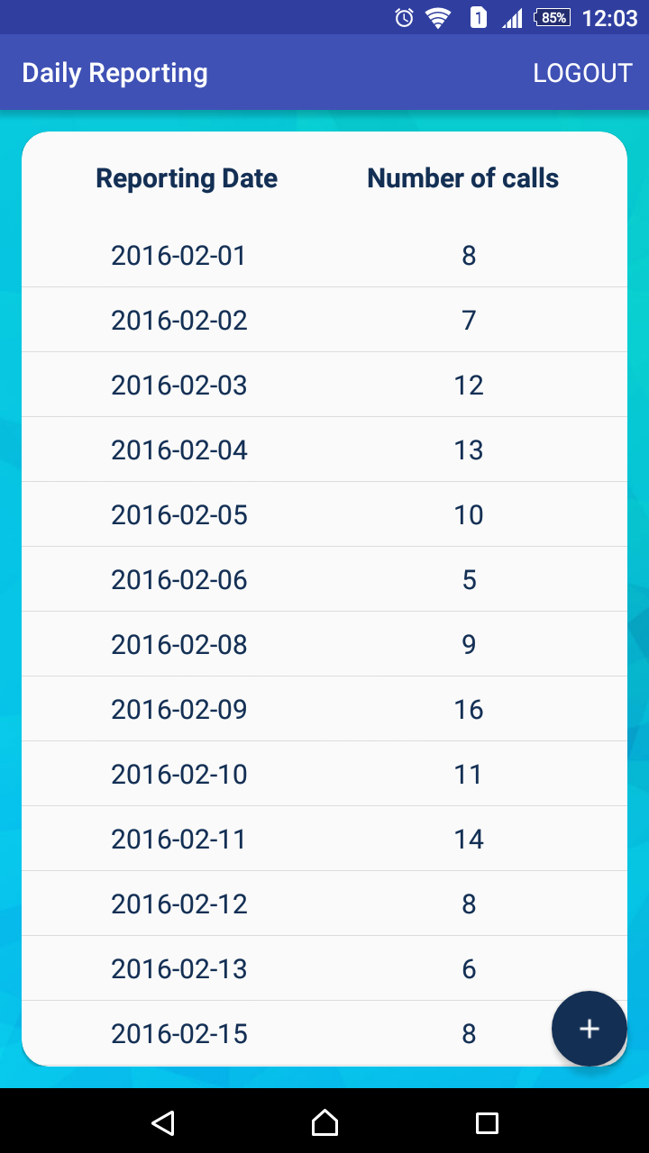
DAILY REPORT LIST

Slide 54
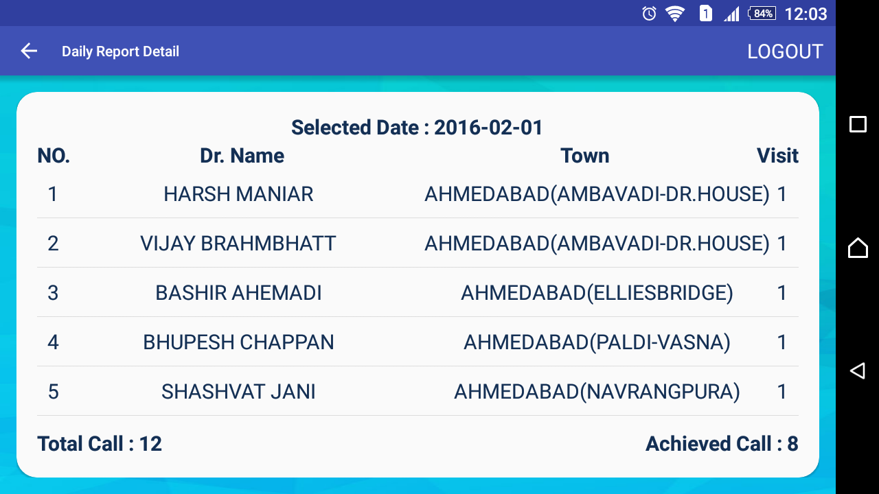
DAILY REPORT DETAIL

Slide 55
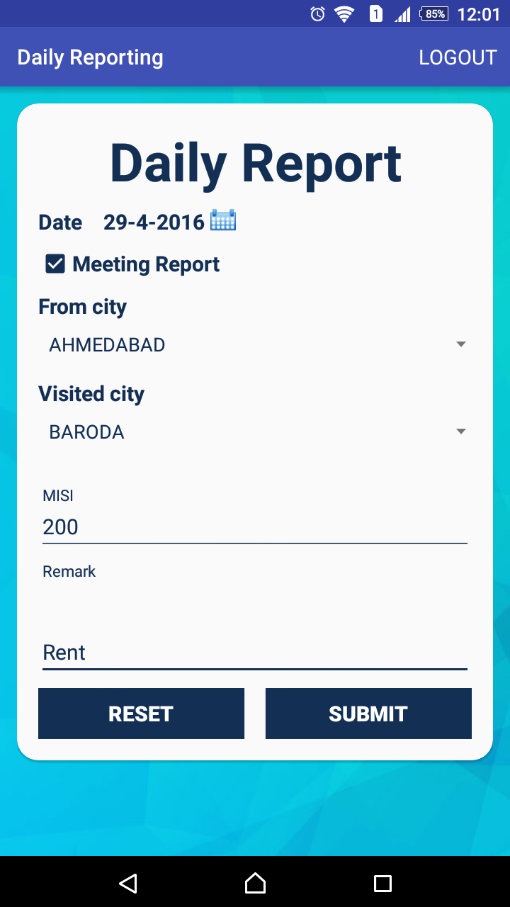
DAILY REPORT

Slide 56
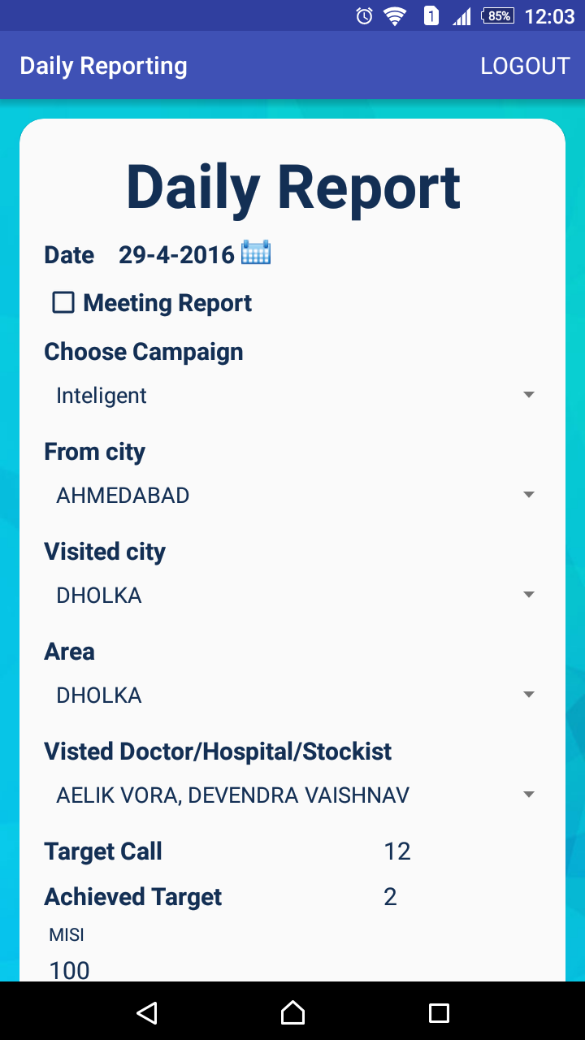
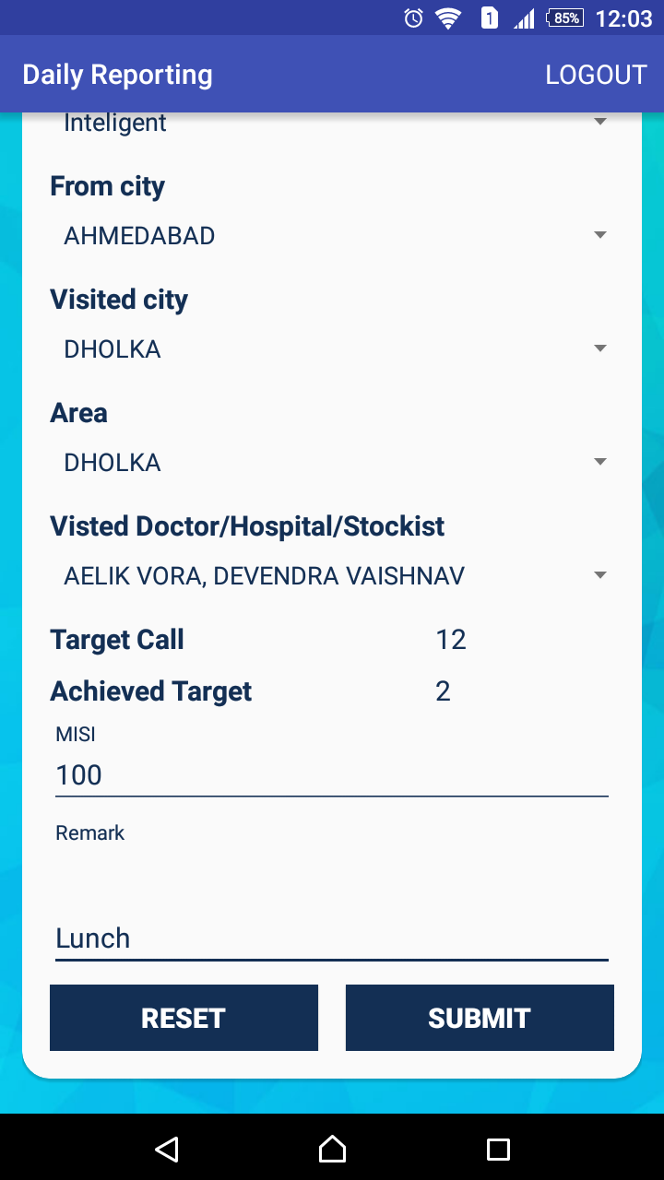

Slide 57
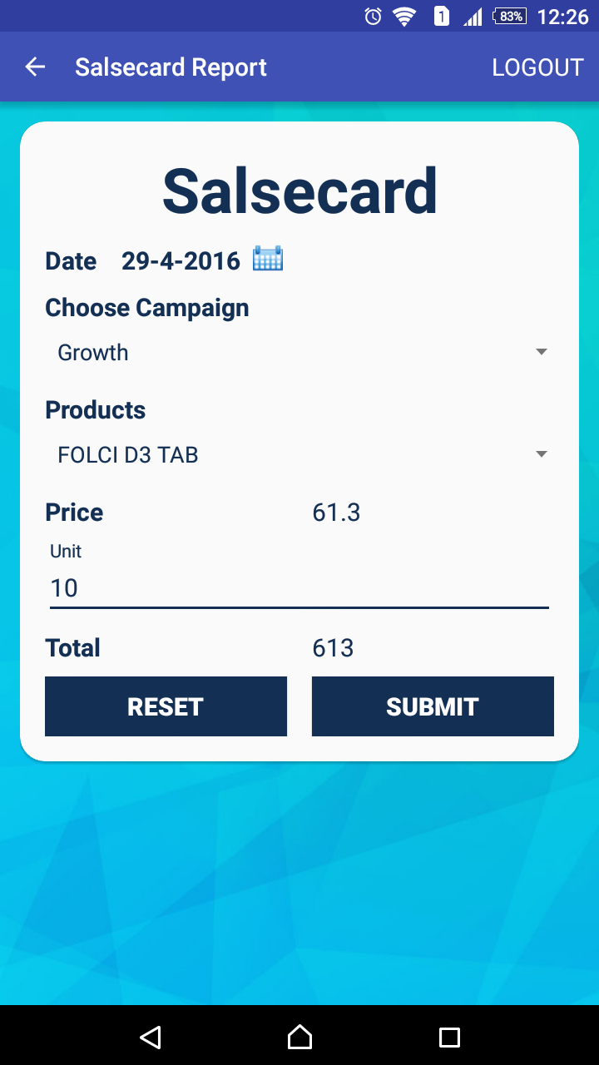
SALSECARD REPORT

Slide 58
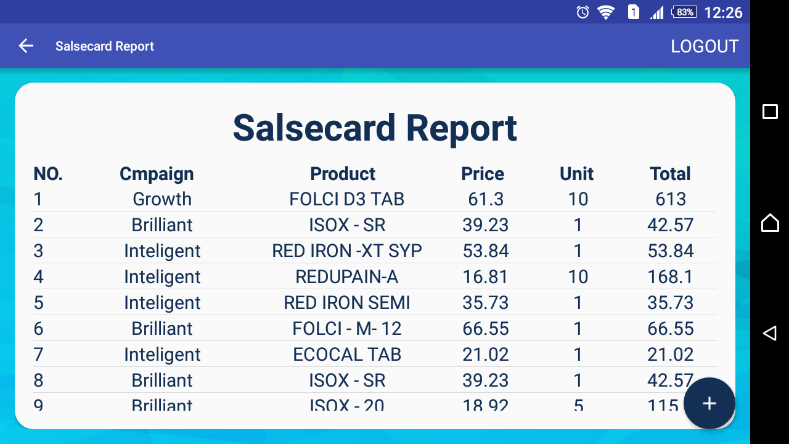
SALSECARD REPORT DETAIL

Slide 59
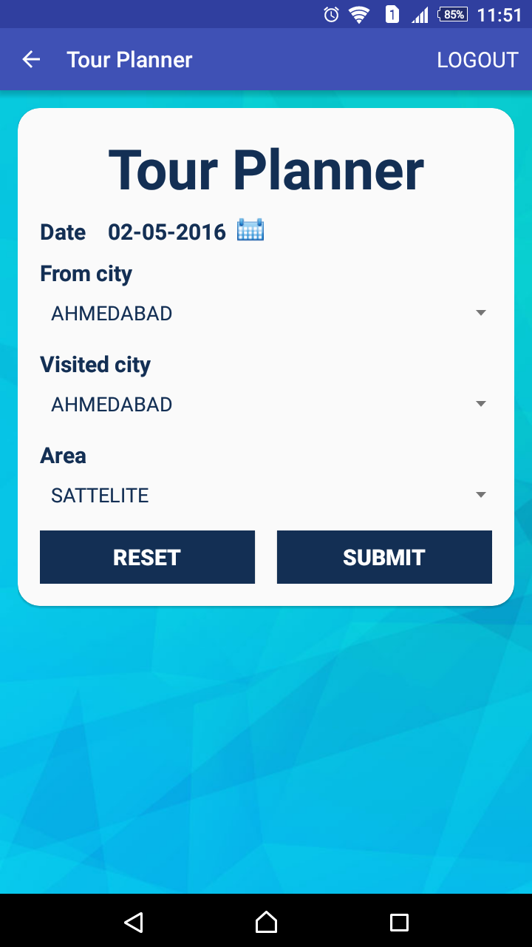
TOUR PLANNER

Slide 60
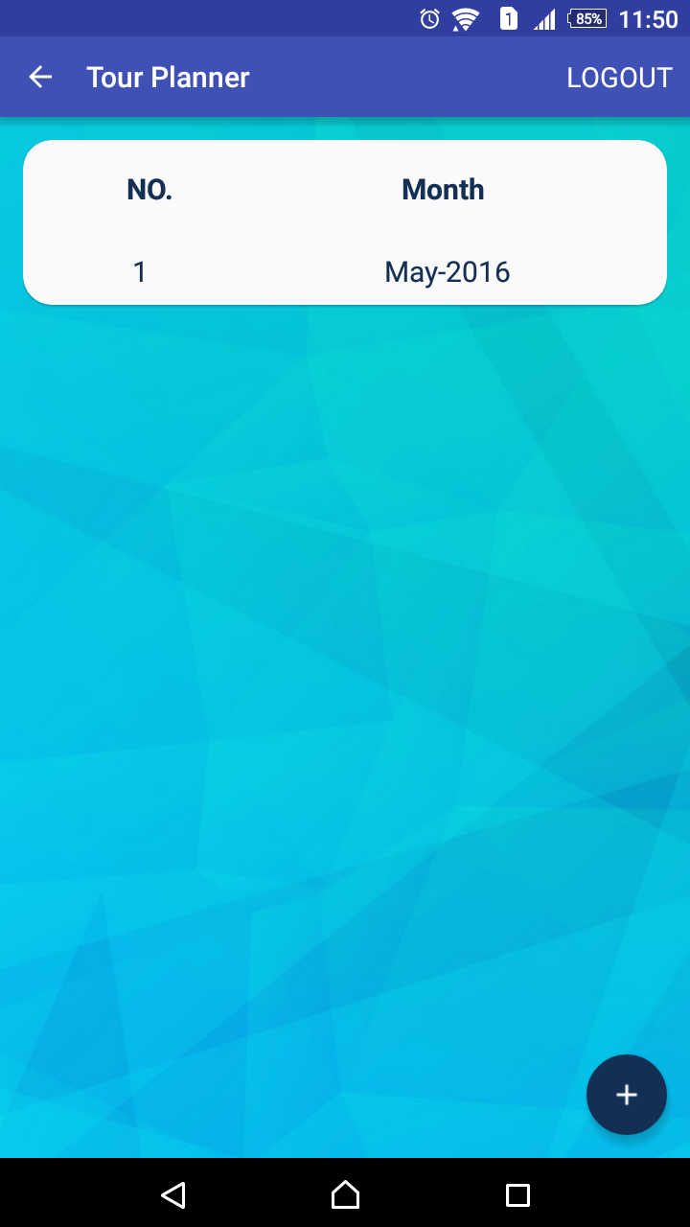
TOUR PLANNER LIST

Slide 61
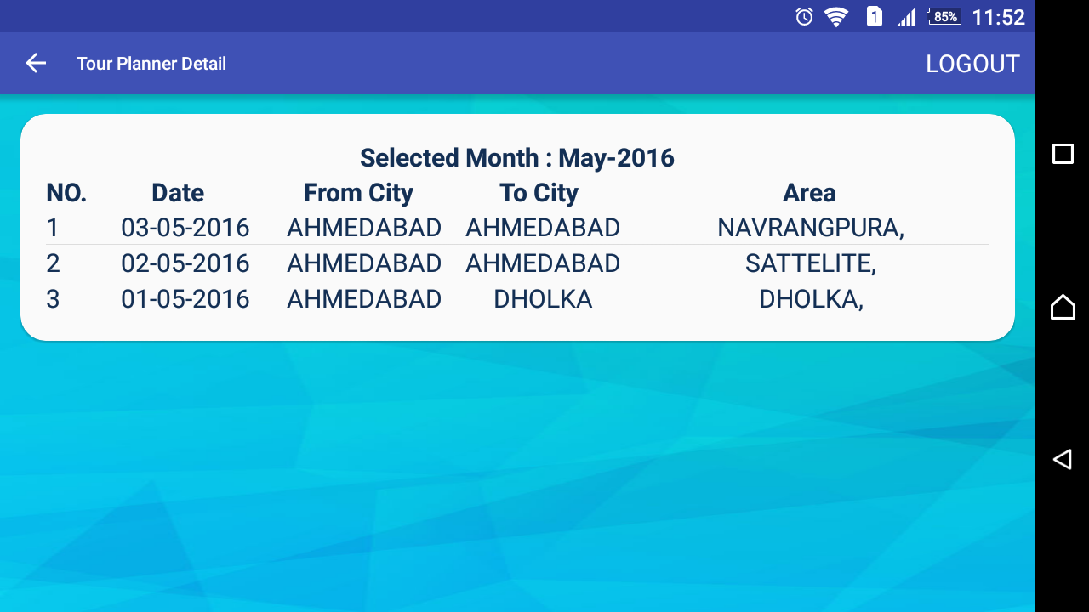
TOUR PLANNER DETAIL

Slide 62
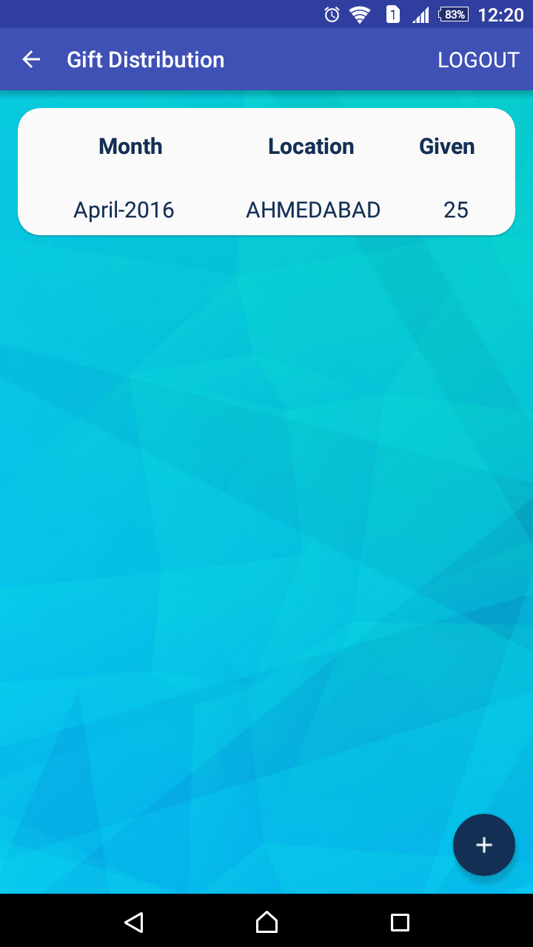
GIFT DISTRIBUTION LIST

Slide 63
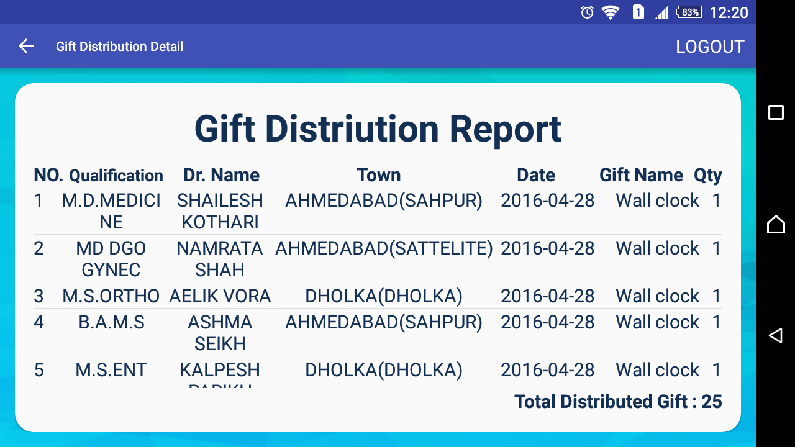
GIFT DISTRIBUTION REPORT
DETAIL

Slide 64
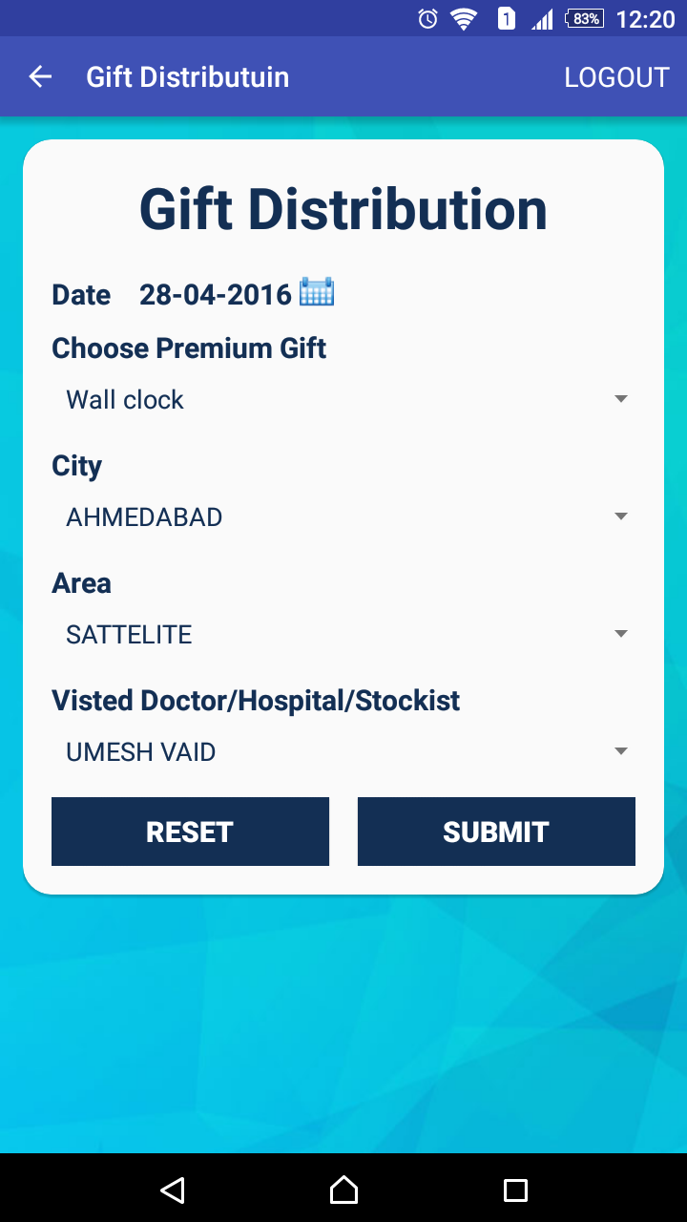
GIFT DISTRIBUTION

Slide 65
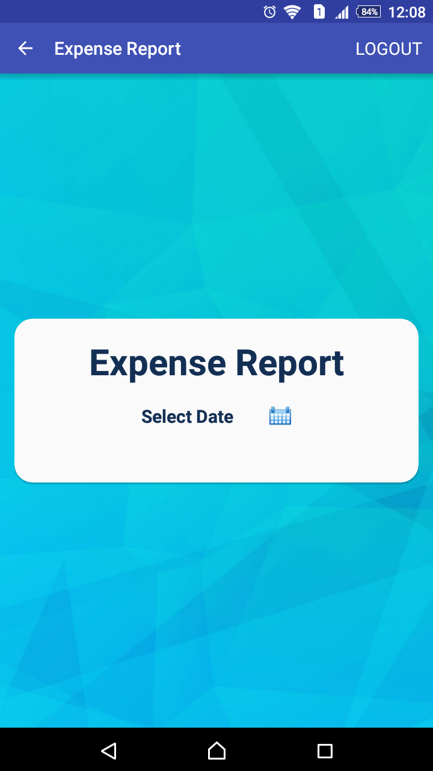
EXPENSE REPORT

Slide 66
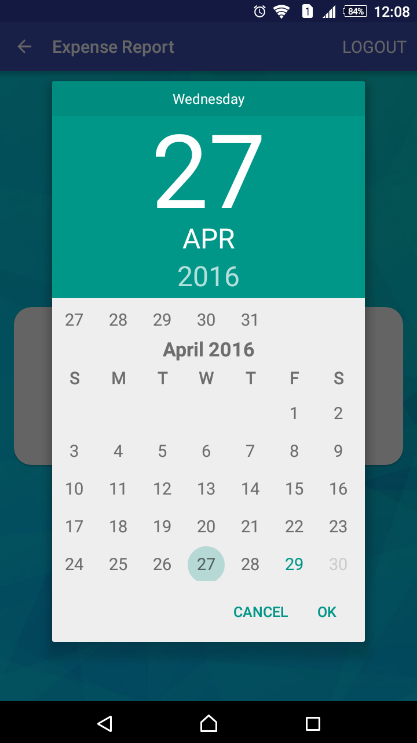
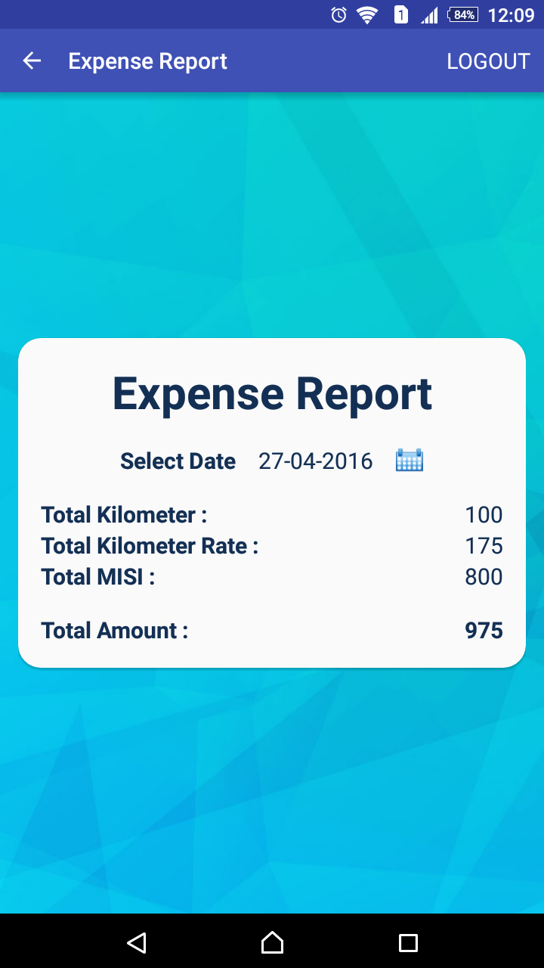

Slide 67
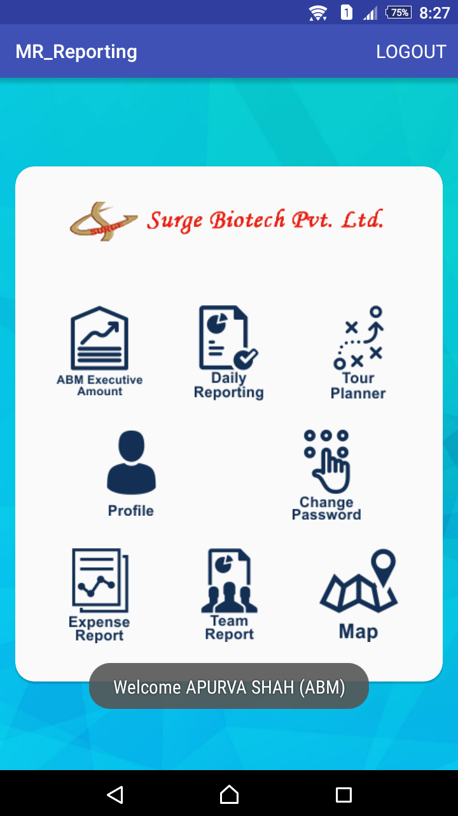
ABM DASHBOARD

Slide 68
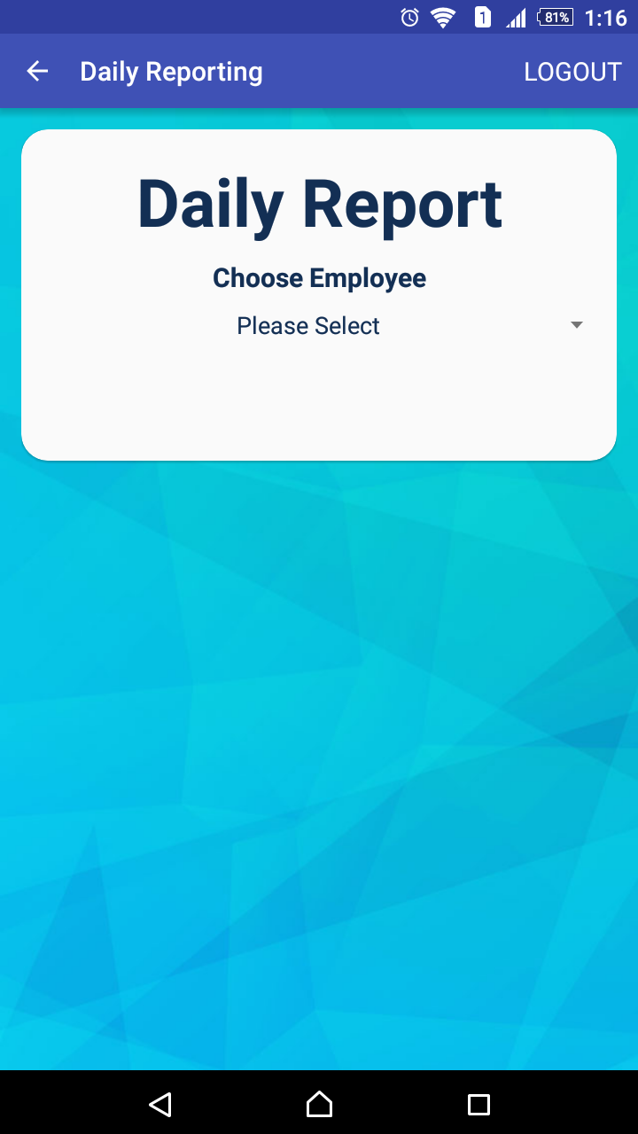
DAILY REPORT ABM

Slide 69
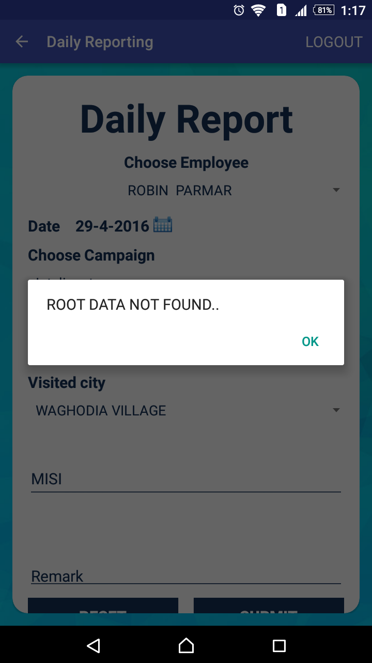

Slide 70
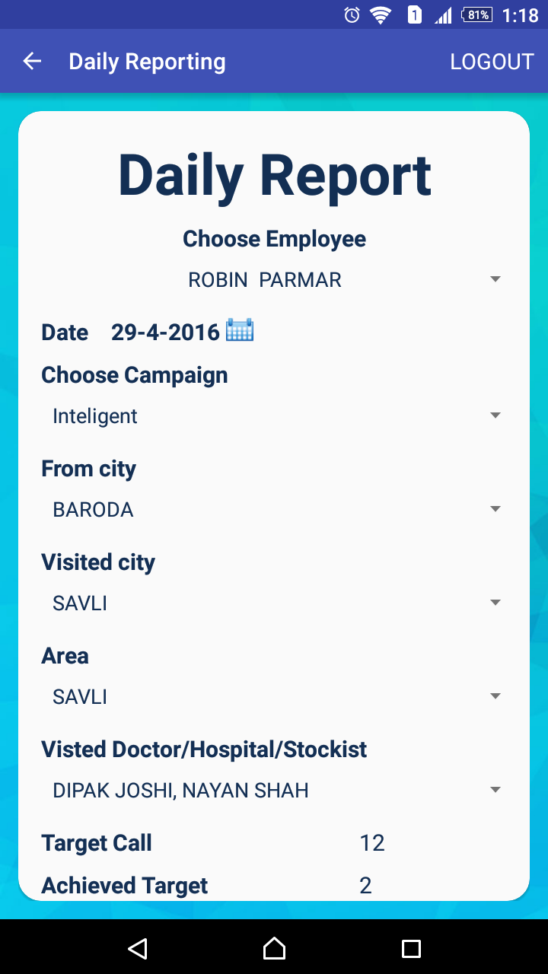
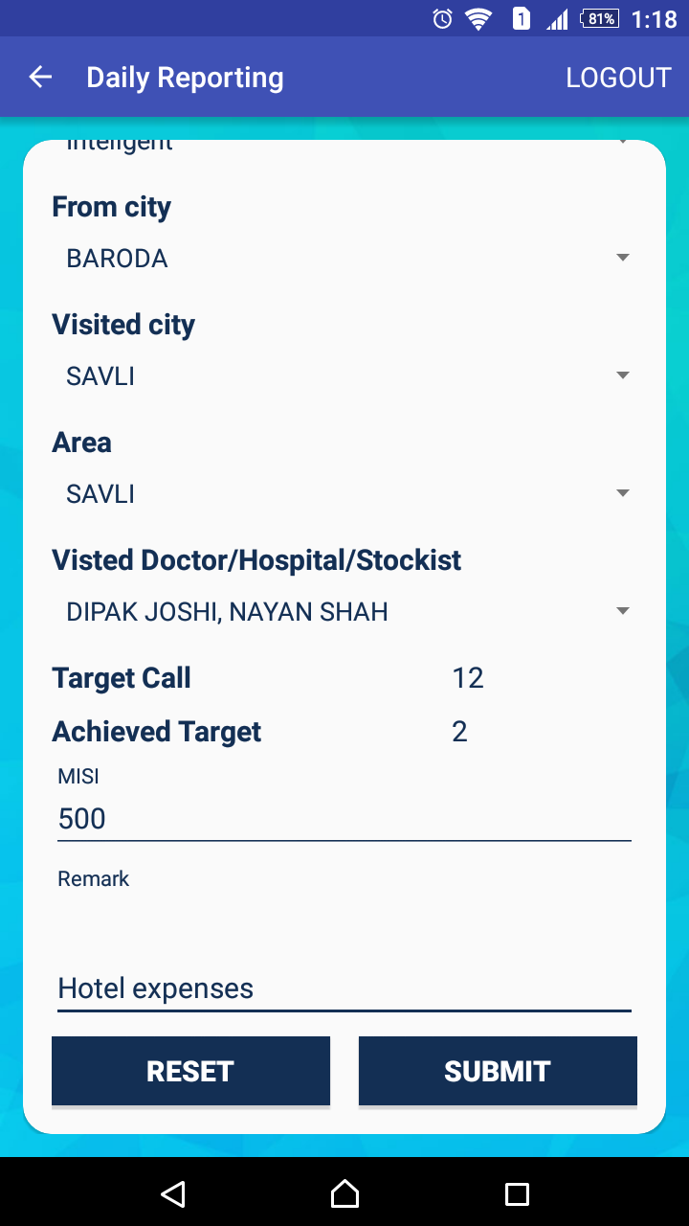

Slide 71
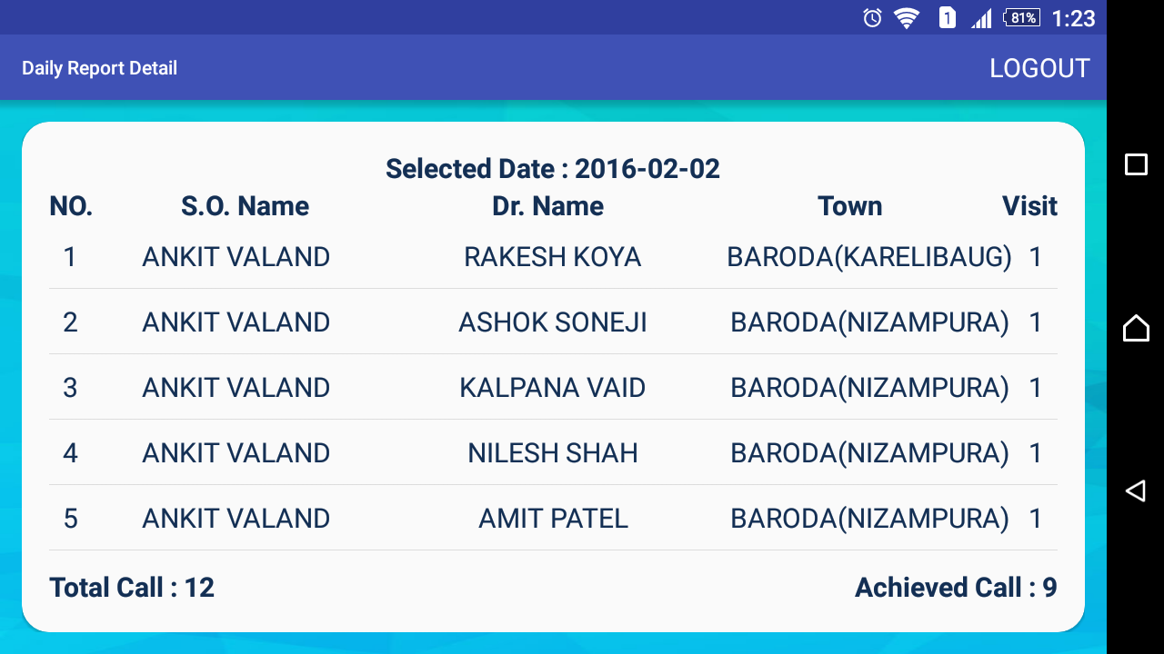
DAILY REPORT DETAIL

Slide 72
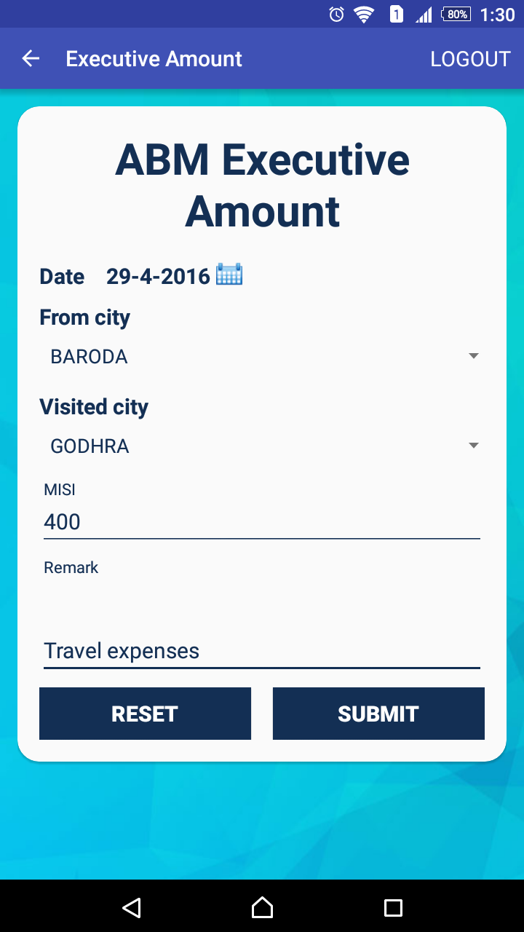
ABM EXECUTIVE AMOUNT

Slide 73
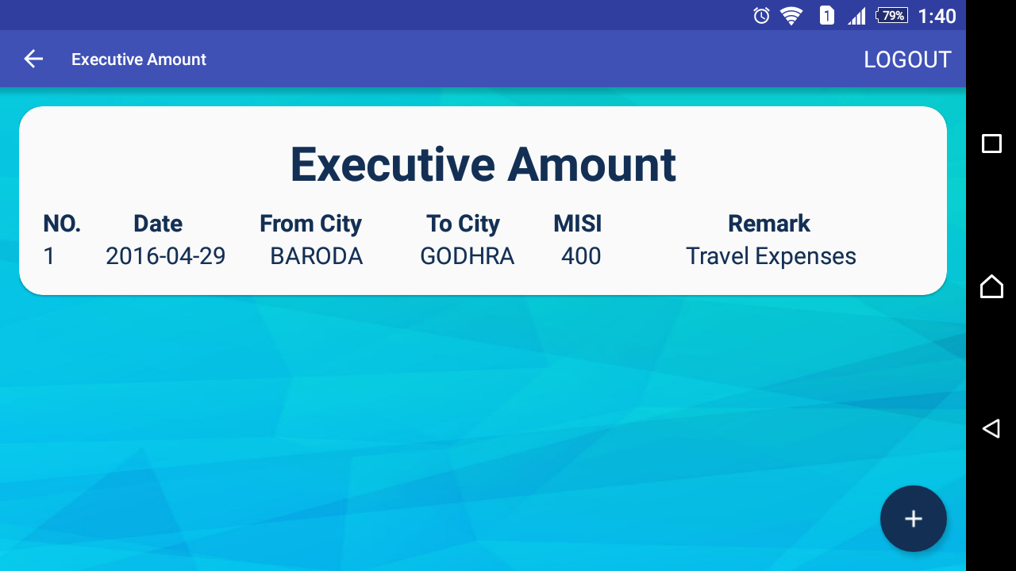
ABM EXECUTIVE AMOUNT
DETAIL

Slide 74
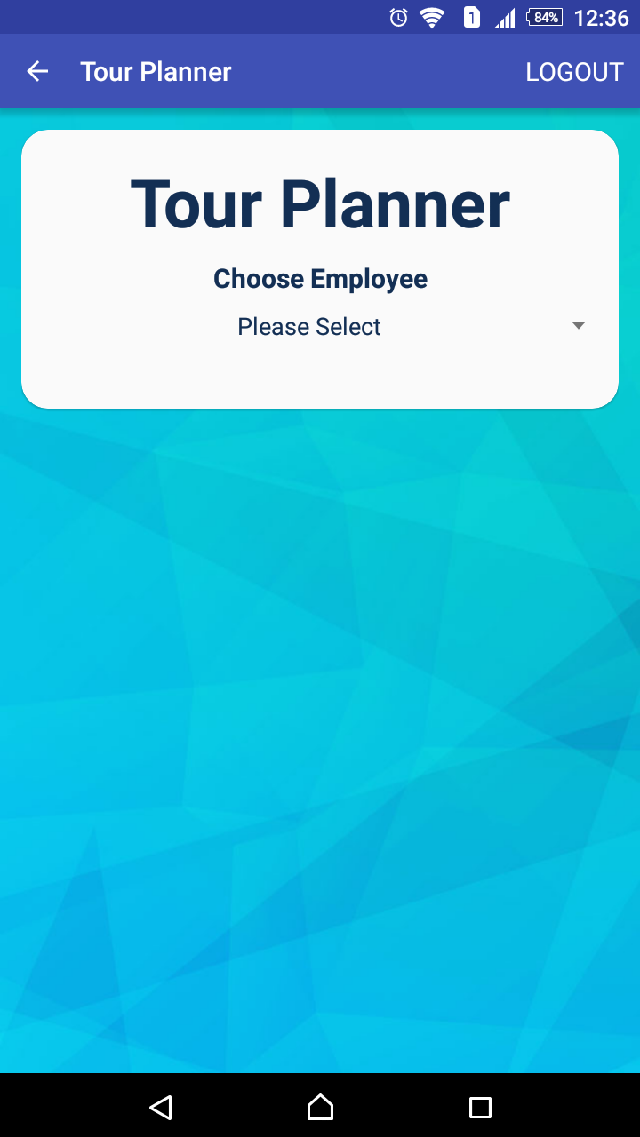
TOUR PLANNER ABM

Slide 75
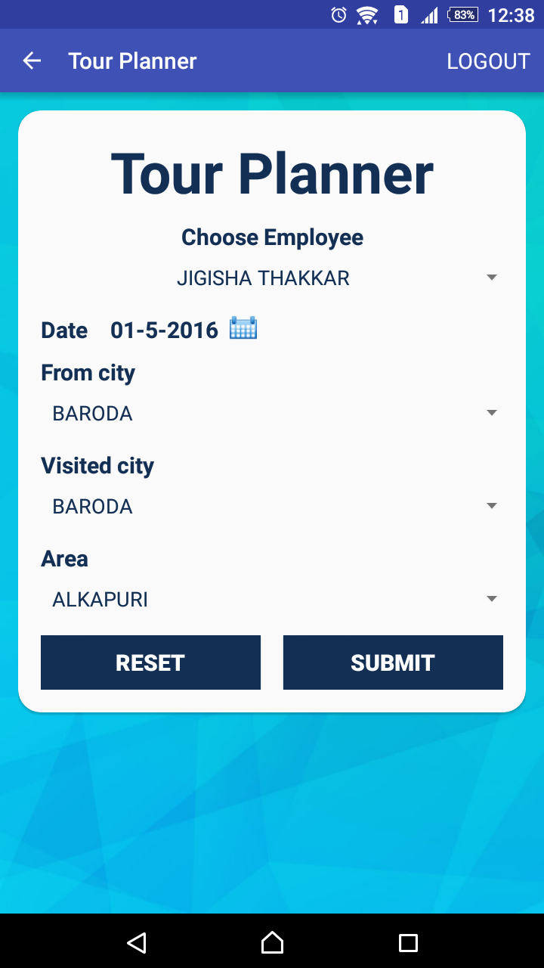

Slide 76
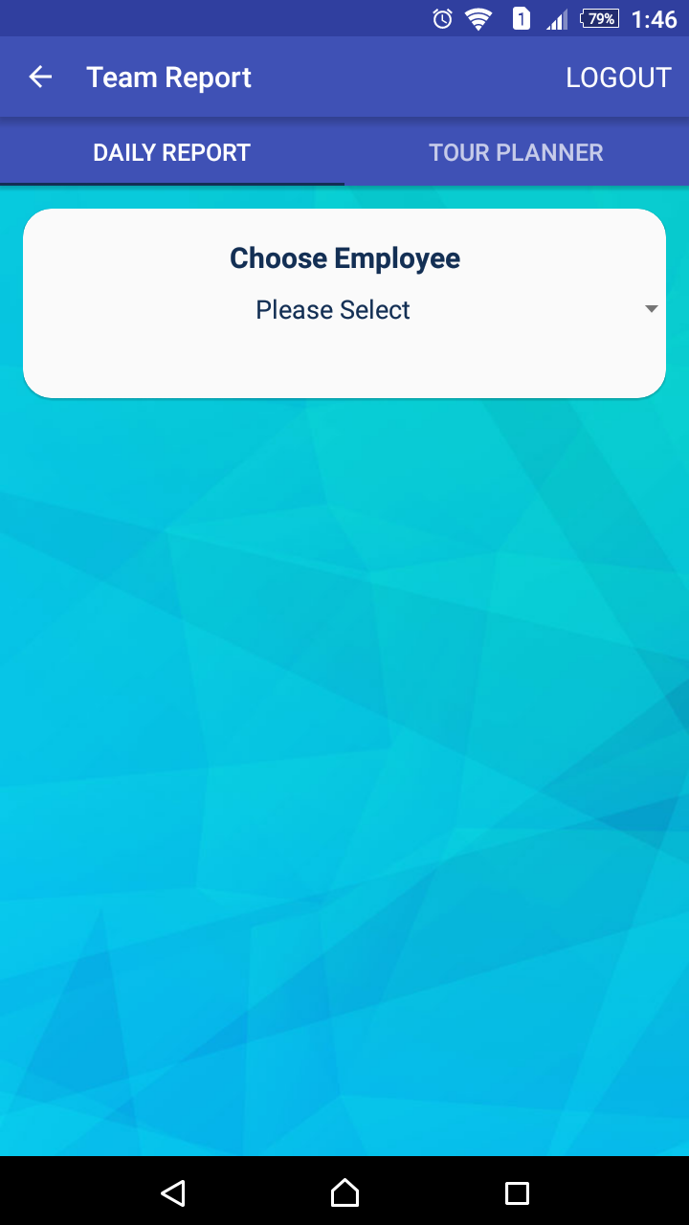
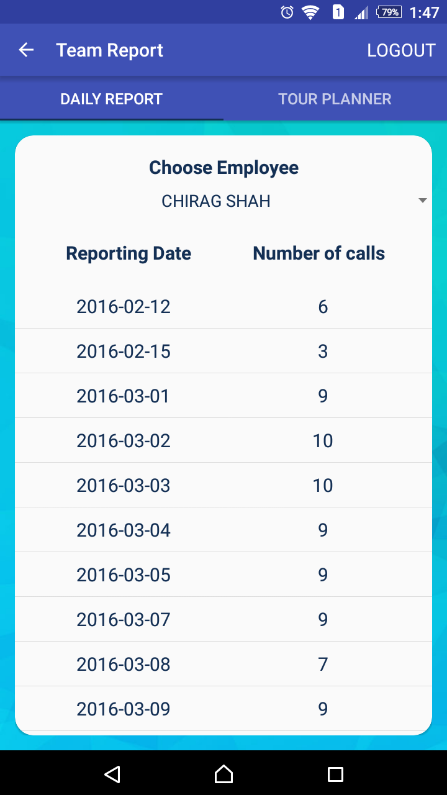
TEAM REPORT
(DAILY REPORT)

Slide 77
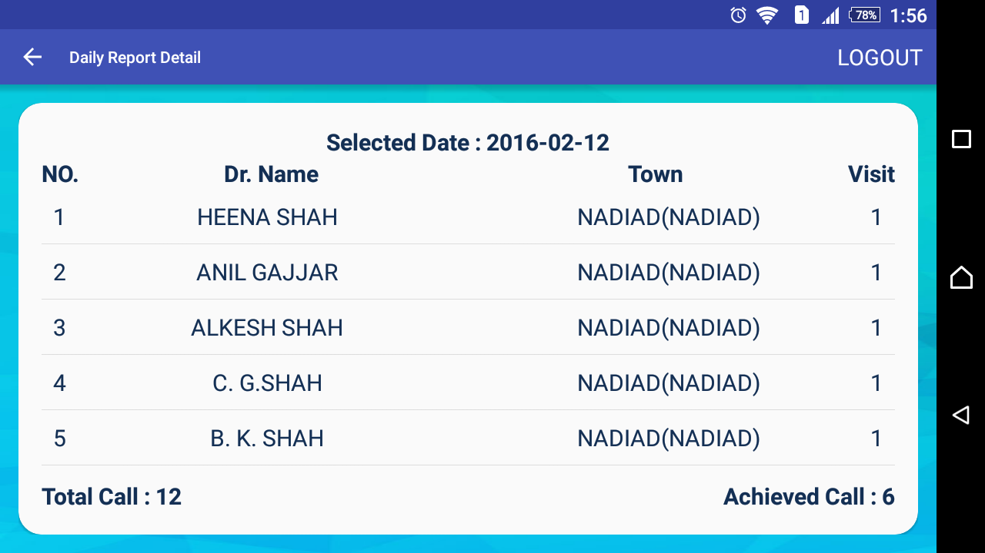
SELECTED EMPLOYEE’S DAILY REPORT DETAIL

Slide 78

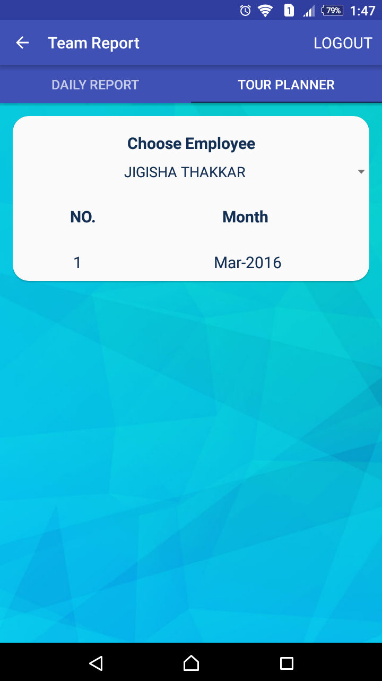
TEAM REPORT
(TOUR PLANNER)

Slide 79
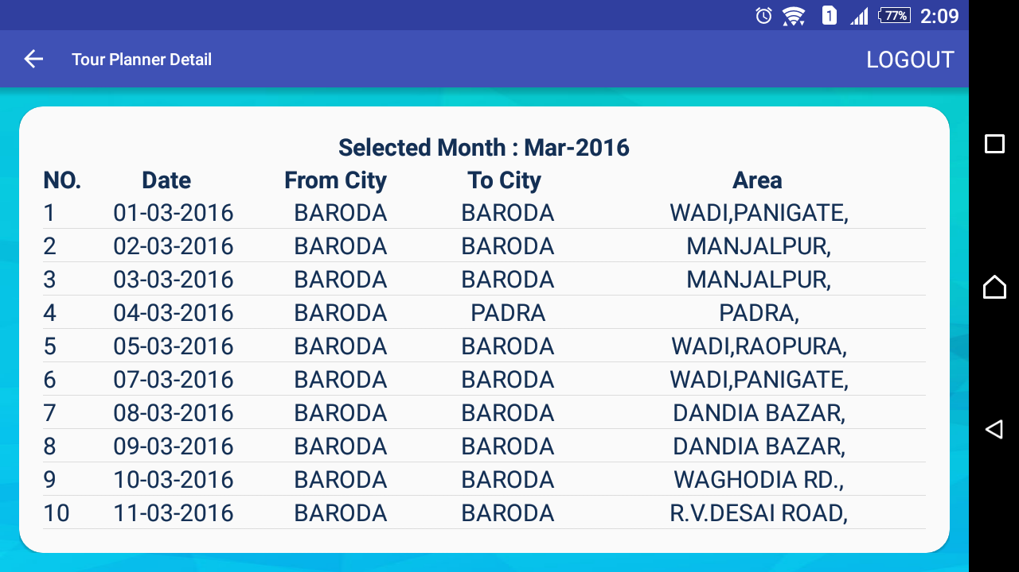
TEAM REPORT
(TOUR PLANNER)

Slide 80
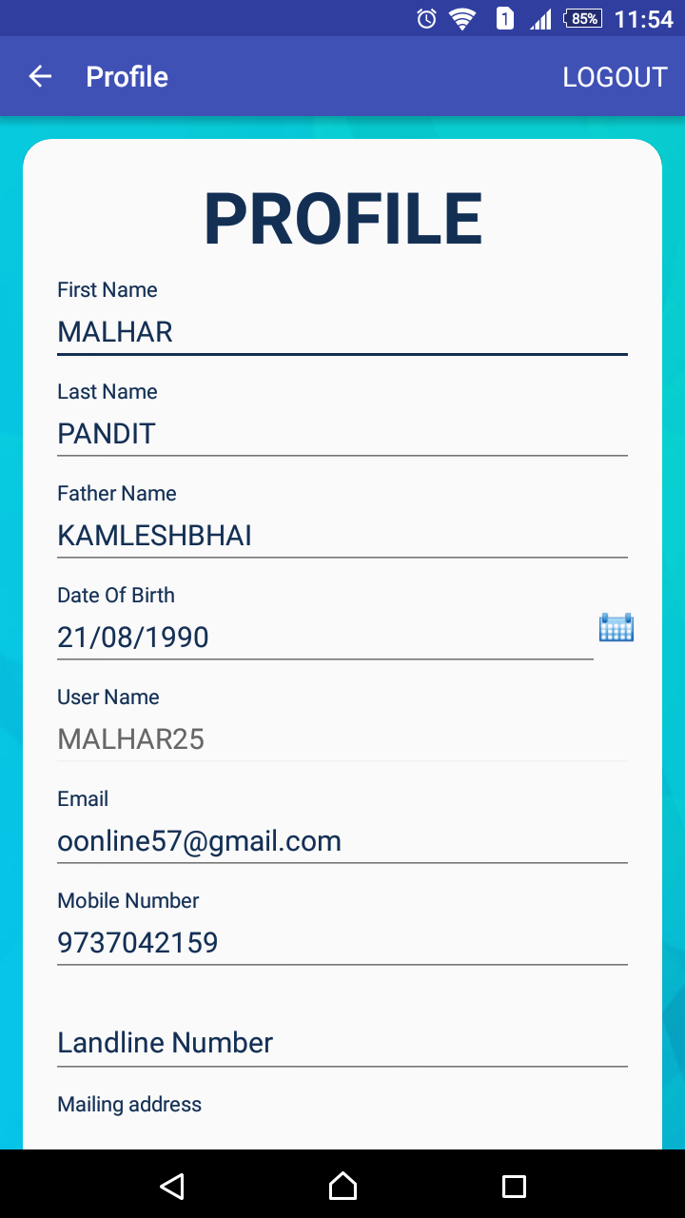
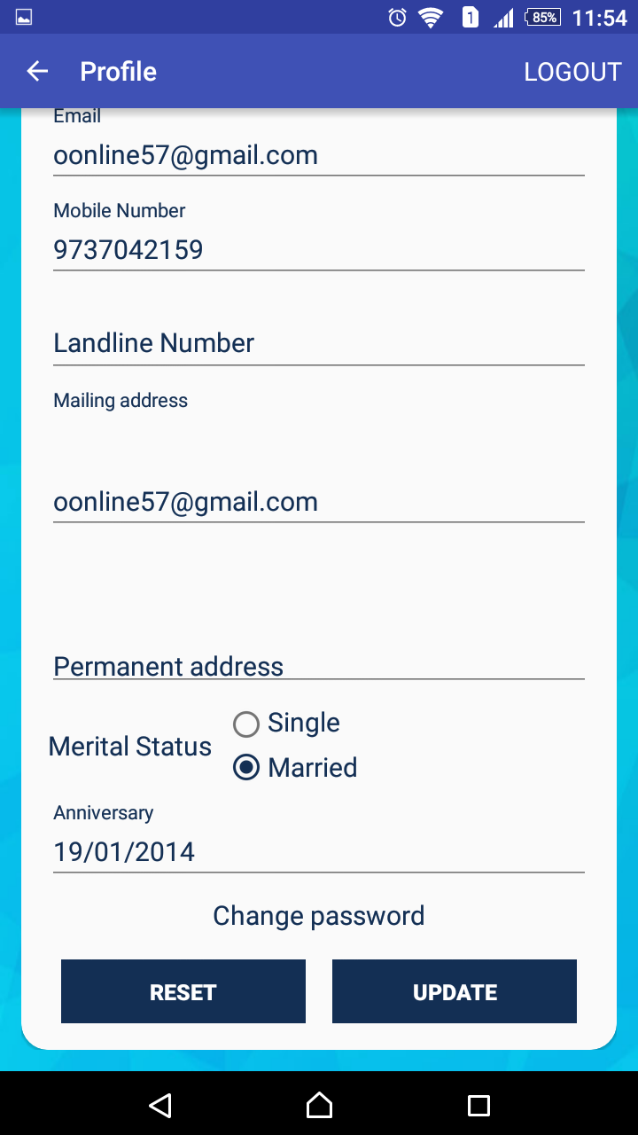
PROFILE ACTIVITY

Slide 81
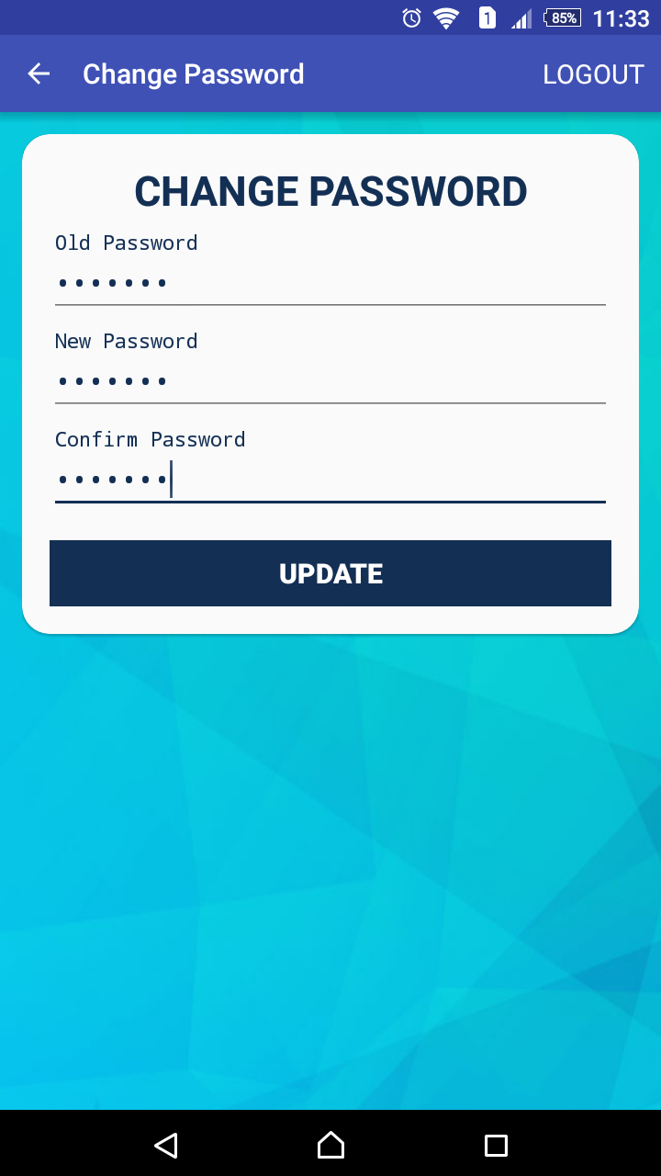
CHANGE PASSWORD

Slide 82
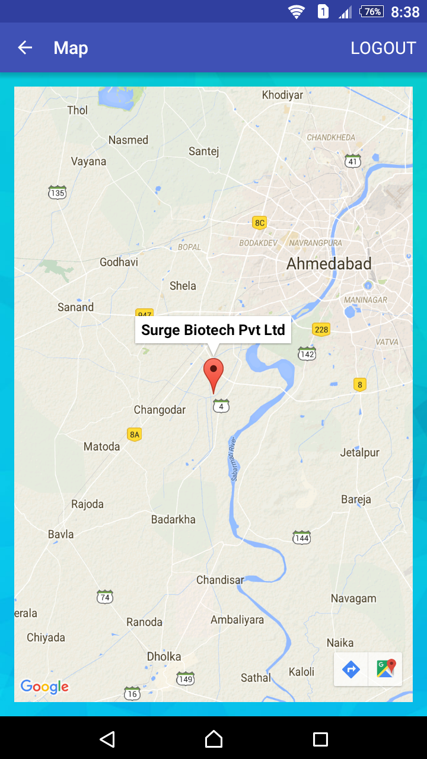
MAP

Slide 83
8. Testing

Slide 84
Testing For Validation
Sr.No | Validation Checking | Excepted Result | Test Result
1 | Datepicker in daily report | Date can select between current date to past 2 days | Pass
2 | Datepicker in Tour Planner | Date must select for next month | Pass
3 | Datepicker in Salsecard | Date must select of current month | Pass
4 | Empty selection in Spinner for campaign, from city, To city, Area, Doctor, Products | Selection Can't be Empty | Pass
5 | Empty Edit Text for Unit in salsecard. | Field Can't be Empty | Pass
6 | Empty Edit Text for old password, New password, Confirm password in change password | Field Can't be Empty | Pass

Slide 85
Testing For Login
Sr.No | Validation Checking | Excepted Result | Test Result
1 | Input valid Username and Password | Login Successfully | Pass
2 | Input Invalid Username and Password | Login Failed | Pass

Slide 86
Testing For Daily report
Sr.No | Validation Checking | Excepted Result | Test Result
1 | Select valid date | Data Added successfully | Pass
2 | Check meeting. | Data Added successfully | Pass
3 | Select valid Campaign, from city, To city, Area, Doctor | Data Added successfully | Pass
4 | Input valid misi. | Data Added successfully | Pass
5 | Input valid Remark | Data Added successfully | Pass

Slide 87
Testing For tour planner
Sr.No | Validation Checking | Excepted Result | Test Result
1 | Select valid date | Data Added successfully | Pass
2 | Select valid Campaign, from city, To city, Area. | Data Added successfully | Pass

Slide 88
Testing For salsecard
Sr.No | Validation Checking | Excepted Result | Test Result
1 | Select valid date | Data Added successfully | Pass
2 | Select valid Campaign and Products | Data Added successfully | Pass
3 | Input valid number of Units. | Data Added successfully | Pass

Slide 89
Testing For abm EXECUTIVE AMOUNT
Sr.No | Validation Checking | Excepted Result | Test Result
1 | Select valid date | Data Added successfully | Pass
2 | Select valid From city and Tocity | Data Added successfully | Pass
3 | Input valid misi and remark | Data Added successfully | Pass

Slide 90
Testing For gift distribution
Sr.No | Validation Checking | Excepted Result | Test Result
1 | Select valid date | Data Added successfully | Pass
2 | Select valid Gift, City, Area and Doctor | Data Added successfully | Pass

Slide 91
Testing For profile
Sr.No | Validation Checking | Excepted Result | Test Result
1 | Input valid First name, Last name,Father name, Email, Mobile, Address. | Data Updated successfully | Pass
2 | Select valid D.O.B. | Data Updated successfully | Pass
3 | Choose valid marital status. | Data Updated successfully | Pass

Slide 92
Testing For Change password
Sr.No | Validation Checking | Excepted Result | Test Result
1 | Input valid old password, New password, Confirm password | Data Updated successfully | Pass

Slide 93
9. Future Enhancement
We will introduce role of ZM and MD for this app.
We will introduce chatting facility for MR and ABM.
We will introduce reminder notification feature for MR and ABM.
We will introduce offline mode to this app.
We will work on performance related issues.

Slide 94
10. Bibliography
To develop this app called “MR Reporting” we used Android Studio and we take some references that given below.
www.developer.android.com
www.androidhive.info
www.stackoverflow.com
www.tutorialspoint.com
www. materialdesignthemes.com
www.flaticon.com
www.color-hex.com
www.github.com

Slide 95
BOOKS
⇨ Android Book: -
Book Name: - Android Studio Development Essentials – Android 6 Edition
Author: - Neil Smyth
Publisher: Payload Media
⇨ PHP and MYSQL Book: -
Book Name: - Beginning PHP and MySQL, 4th Edition
Author: - W. Jason Gilmore
Publisher: - Apress

Slide 96
Thank You ☺

